Slide 1


IPS Academy , Indore
Institute of Engineering and Science
(A UGC Autonomous Institute , Affiliated to RGPV , Bhopal )
Department of Computer Science & Engineering
2021-22
“Personal Finance Manager”
Presented By- Guided By-
Devanshu Das (0808CS191060) Ms. Namarata Atre
Priyanshi Pundir (0808CS191148)
Sanskar Babel (0808CS191168)
Skand Sharma (0808CS191178)

Slide 2
Content
Introduction
Study of similar projects
Problem domain
Solution domain
Requirement specification
Expected Outcome
Reference

Slide 3
Introduction
Personal finance is a term that covers managing your money as well as saving and investing. It encompasses budgeting, banking, insurance, mortgages, investments, retirement planning and tax and estate planning. The term often refers to the entire industry that provides financial services to individuals and households and advises them about financial and investment opportunities. In our project we are just covering expense and investment tracking.
The project titled “Personal Finance Manager” is a website for monitoring and controlling the personal expense and investment of an individual. The project “Personal Finance Manager” is developed in HTML, CSS and PHP which is mainly focuses on the basic personal finance management like tracking expense and investment tracking

Slide 4
Problem Domain
Before getting the idea of making this website we were familiar with other website and application present in the market but by using it with time we have encountered several problems with these website.
The problems that we have encountered are:
Not Affordable.
Many scams involved.
Not value for money.
Biased towards the sponsorship.
In existing, we need to maintain the Excel sheets, CSV etc. files for the user daily and monthly Income and expenses. In existing, there is no as such complete solution to keep a track of its daily expenditure easily. To do so a person as to keep a log in a diary or in a computer, also all the calculations needs to be done by the user which may sometimes results in errors leading to losses.

Slide 5
Solution Domain
After encountering all the problems we came up with our website which we believe will resolve most of the problems efficiently.
Our proposed website has several advantages:
Affordable.
No in-site purchases (No scams involved).
Value for money (Most of the features are free).
Expense tracker
There are several key feature in our proposed website which makes our website different from the others.
To reduce manual calculations, we propose an application which is developed by HTML, CSS, JS and PHP. This application allows users to maintain a digital automated diary. Each user will be required to register on the system at registration time, the user will be provided id, which will be used to maintain the record of each unique user.

Slide 6
Requirement Specification
Hardware Requirement Software Requirement
Processor : INTEL Core i3 Operating System : Windows 7
Ram : 512 MB Language : HTML, CSS, PHP
Hard disk : 1 GB Database : MySql
Monitor : 15” Color monitor
Key board : 122 Keys

Slide 7
Expected Outcome
Through some previous research we found that all basic things are needed in an investment website or an application. People who are into investments want to know all about their finances, investment and expenses. There are many tools in the market which makes it easy to keep track of your investments and expenses.
Keeping in mind all the problems that we have discussed and encountered we came up with the idea of Personal Finance Manager which is a website cum tool which helps consumers with all the finances that is necessary.
The outcomes that are expected
Affordability.
One stop for Personal finances.
Simple and easy to use.
Provide some learning for the young generation.
User friendly.

Slide 8
Input Data
This website is designed to manage and track your expense and investments at one place. For that each user must have to register in the tool by entering the unique email address, mobile number, name and password. This all date will be stored in our database.
Login/Register: User have to enter the personal details for creation of the unique accountholder.
Amount and Category: As this is the expense tracker and manages your expenses on daily, weekly, monthly, and yearly basis you have to enter your expense amount, type and date.
Output Data
Each user will be required to register on the system at registration time, the user will be provided id, which will be used to maintain the record of each unique user
Dashboard: After the user logged in the system will show the dashboard to the user giving user the overview of the expense that the user has made.
Report: User will be able to get the expense report on daily, weekly, monthly or yearly basis for keeping the offline or hard copy for the detailed report.
Manage: User can edit or manage their profile information and they can also manage and edit their expenses in case of any incorrect entry of any data.

Slide 9
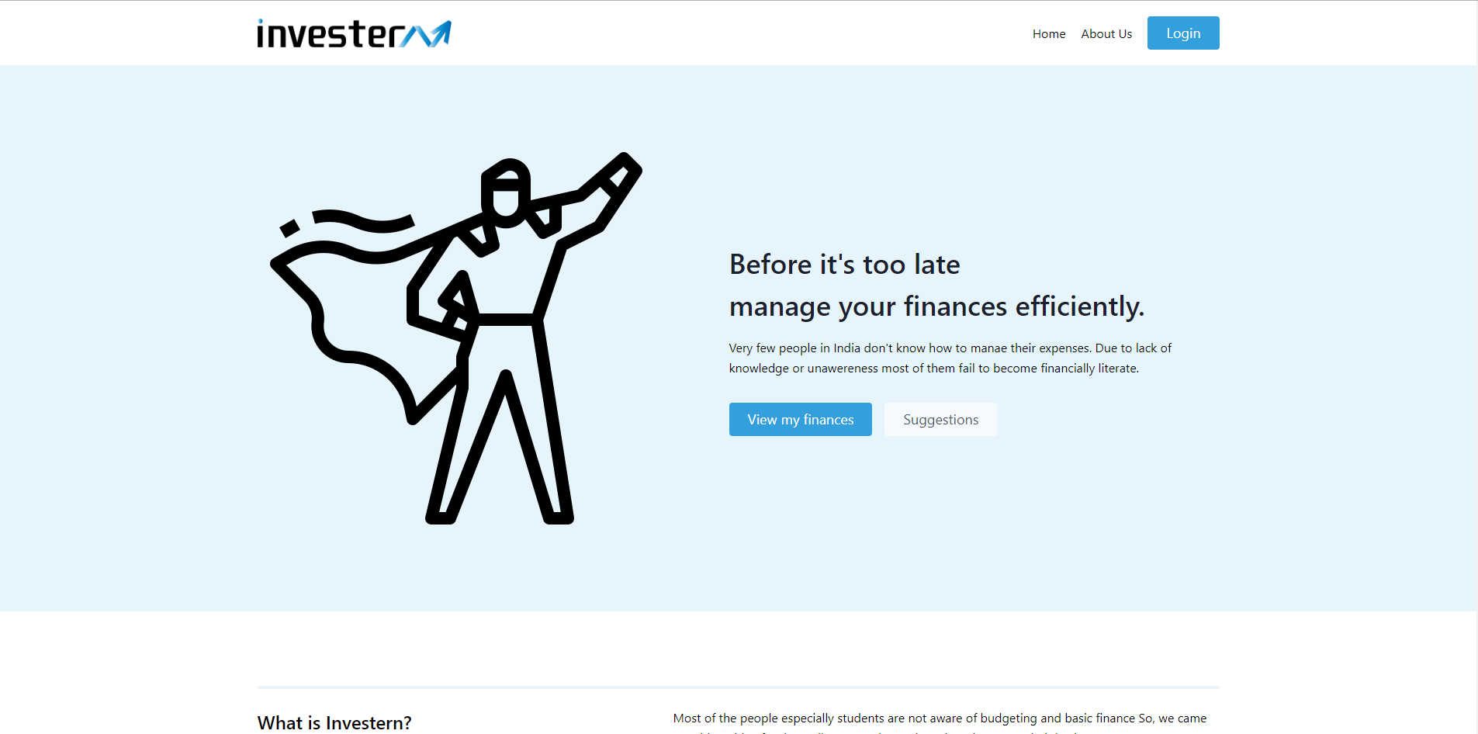

Slide 10
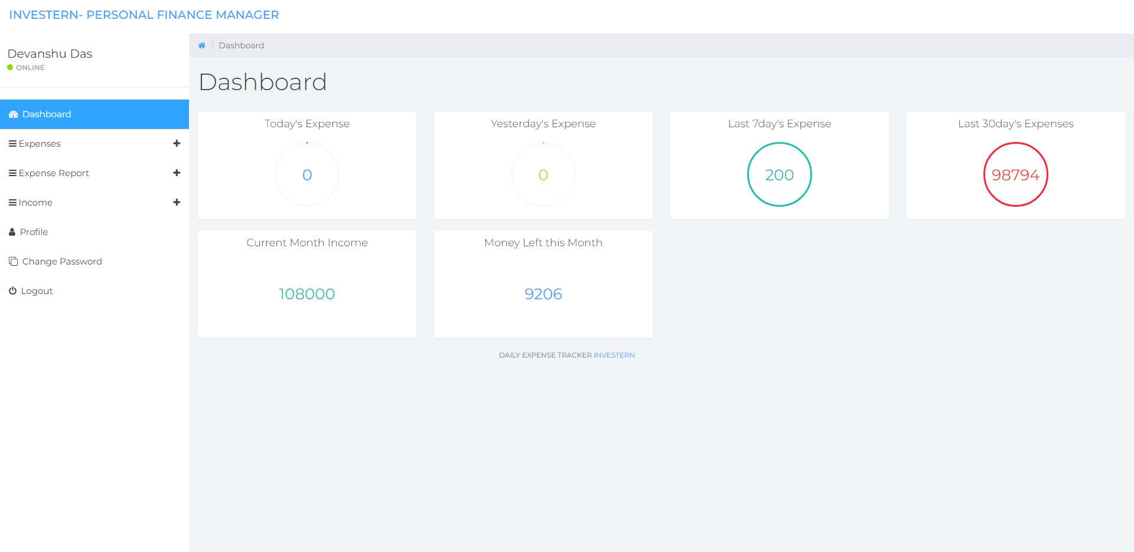

Slide 11
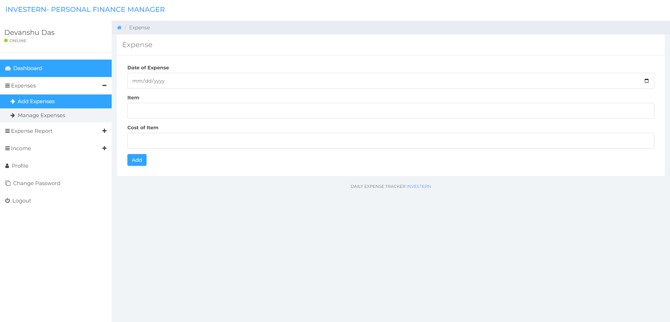

Slide 12
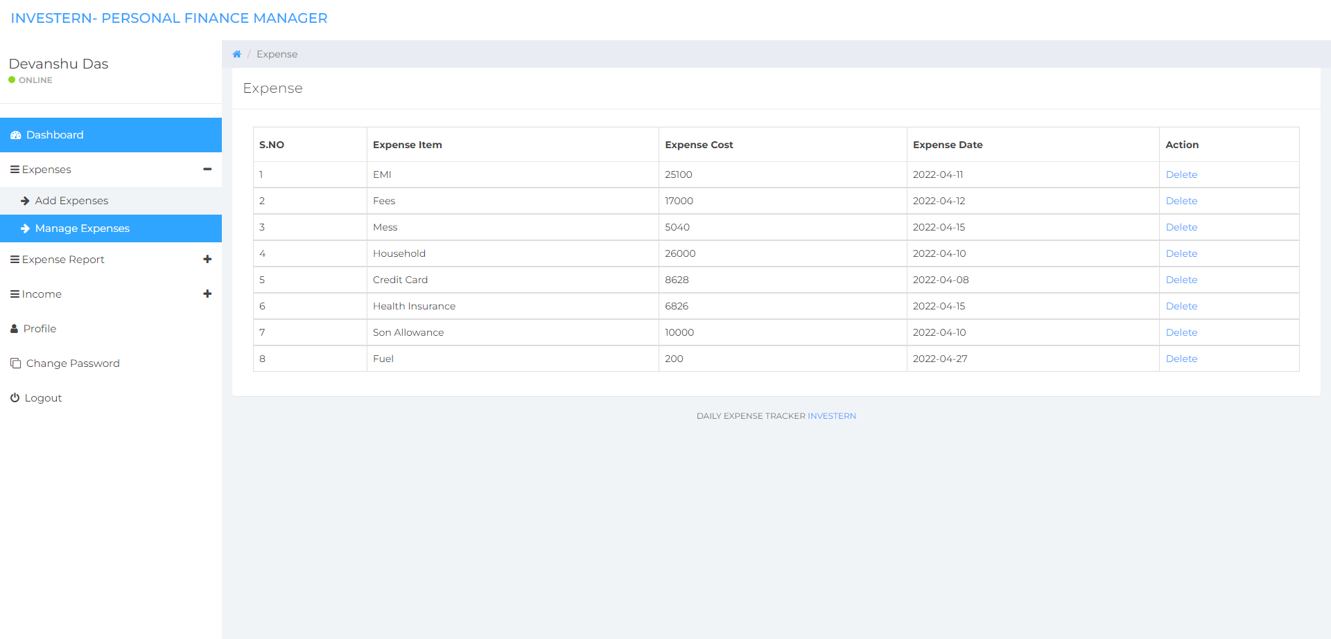

Slide 13
Reference
[1] https://www.w3schools.com/html/default.asp
[2] https://www.w3schools.com/css/default.asp
[3] https://github.com/mertJF/tailblocks
[4] https://www.geeksforgeeks.org/tailwind-css/?ref=lbp
[5] https://www.w3schools.com/mySQl/default.asp
[6] https://www.w3schools.com/php/default.asp

Slide 14
Thank You

